Slide 1

Merge
with
Magist?

Slide 2

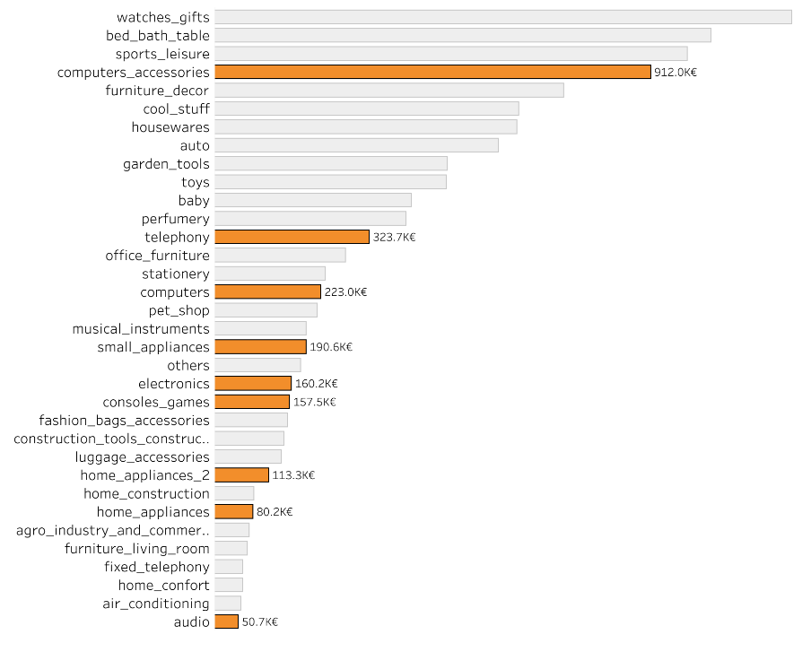

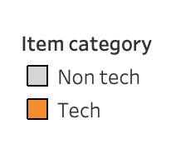
Can Magist handle our customers demand for
high end Apple products?

Slide 3
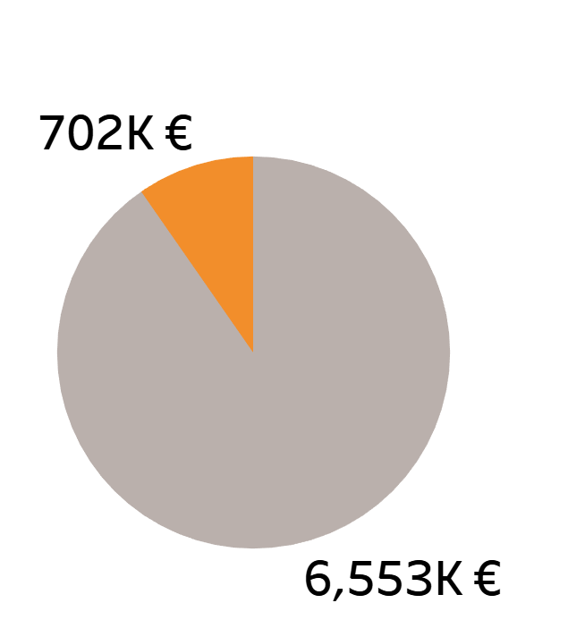
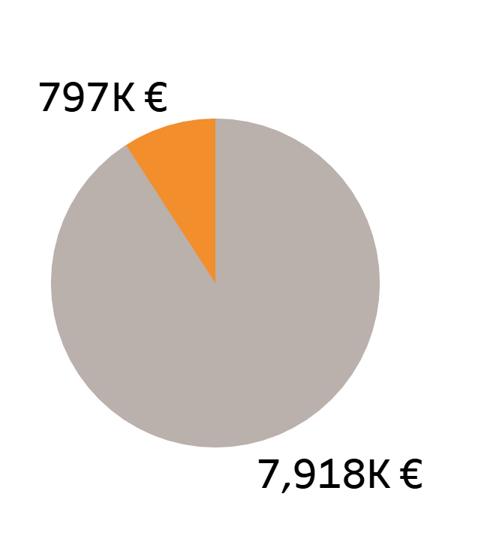
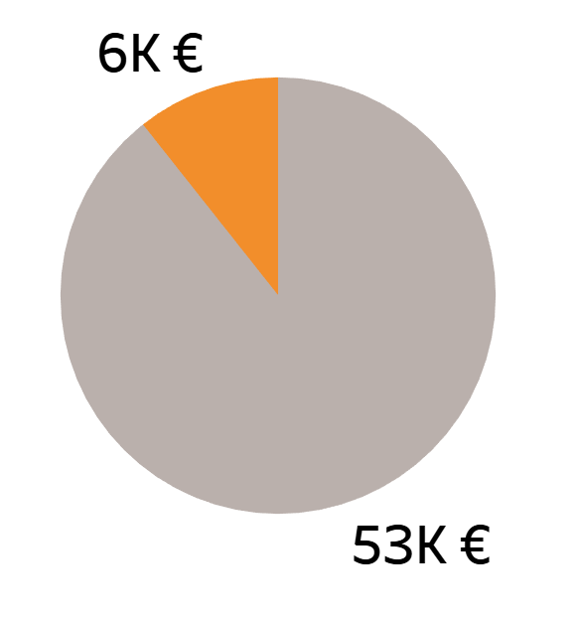
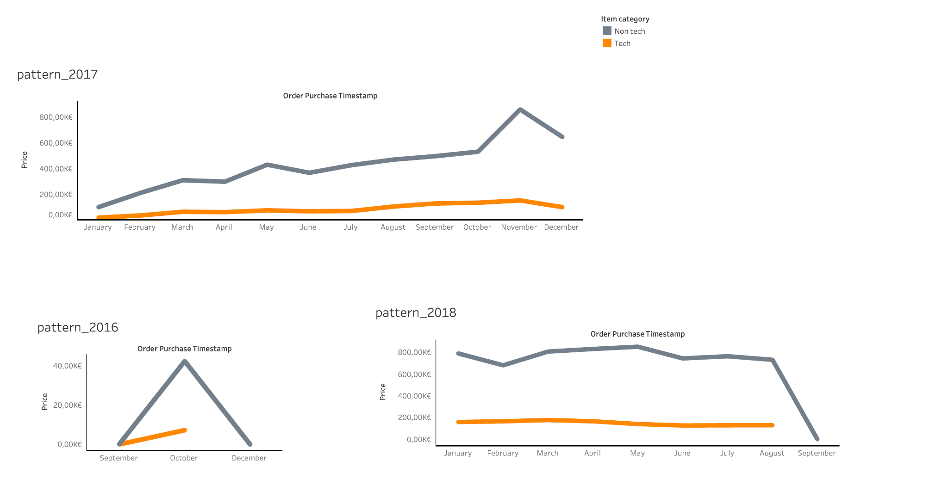
Magist Revenue Allocated by Tech and Non Tech Inventory
11% of Sales in 2016
10% of Sales in 2017
9% of Sales in
2018

Slide 4




Delivery service
Placed orders over period (12.2016 - 01.2018): 99,441
Actually delivered:
97%
11% orders arrived with delay:
5% week delay
2% more than a month delay

Slide 5

Merge
with
Magist?
Based off our findings my team and I do not recommend going forward with the contract.

Slide 6
Appendix

Slide 7
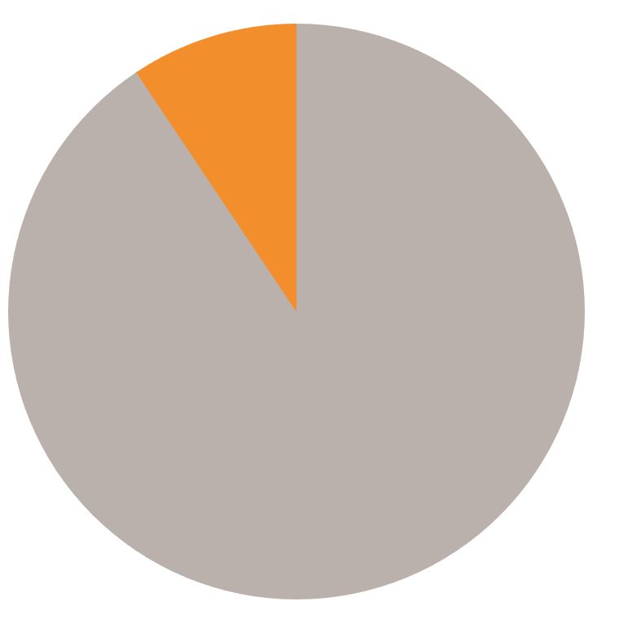
Percentage Allocation of Tech Items of Total Revenue
9,3%
Tech
Total Revenue 16,028.685
90,7%
Non Tech

